Slide 1
Object Oriented Design and C
David Sackstein

Slide 2
Overview
In Module 1 we discussed the benefits of OOD. In particular, that it helps us enforce encapsulation and enables programming by interface.
But in some embedded environments, we do not have access to a C++ compiler, and we are stuck with C.
As Bjarne Stroustrup put it, C++ is a better C, but this is not to say we cannot emulate some capabilities in C.
In this module we will explore techniques for implementing Object Oriented Development in C. We will learn how to enforce the visibility of methods, implement interfaces, and work with callbacks that have contexts.
We will also learn about the interoperability of C and C++. This is important because it gives you the choice to upgrade parts of your project from C to C++ without affecting other parts.

Slide 3
Agenda
C and C++ interoperability
A gradual migration to C++
Calling C code from C++
Calling C++ code from C
Defining an object in C
Interfaces in C

Slide 4
Interop
C++ is a superset of C the two languages can be used in the same project (executable, shared library).
This makes it easy to migrate a C project to C++ in small steps.

Slide 5
Calling C code from C++
In C++ function names are not what they seem.
They are mangled to include information about the arguments and their types.
You can prevent the compiler from mangling names using extern “C” {}
To call the functions in c.h from c++ you need to wrap the inclusion of c.h with extern “C” {}

Slide 6
Calling C++ code from C
__cplusplus
For the same reason, you can only call a C++ method from C if it is not name-mangled (or you know it mangled name).
For C++ methods wrap the declaration in the header and the implementation in extern “C”
As extern “C” is invalid syntax in C, wrap its use with ifdef __cplusplus

Slide 7
Defining an object in C
In a header define a struct.
In a c file with the same name, define methods that accept a pointer to the struct as their first parameter (you can call it ‘this’).
Define a constructor and a destructor
In the header declare the methods you want public.
Do not declare the methods you want private
In the source file mark the methods you want private as static.
You can define an interface as a struct containing pointers to functions.

Slide 8
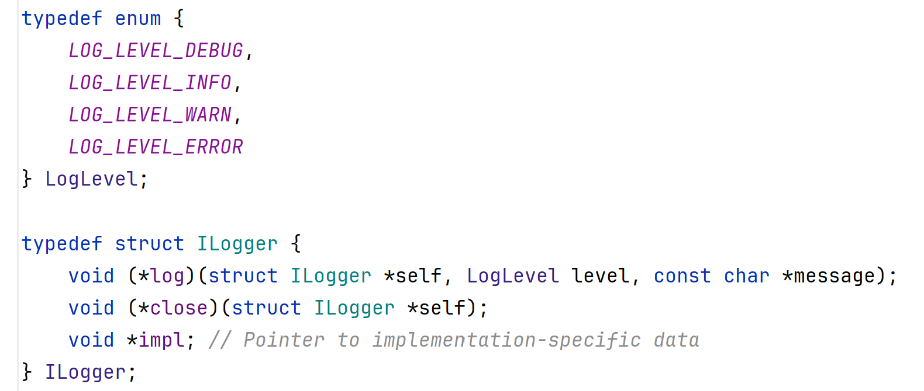
The ILogger interface

Slide 9
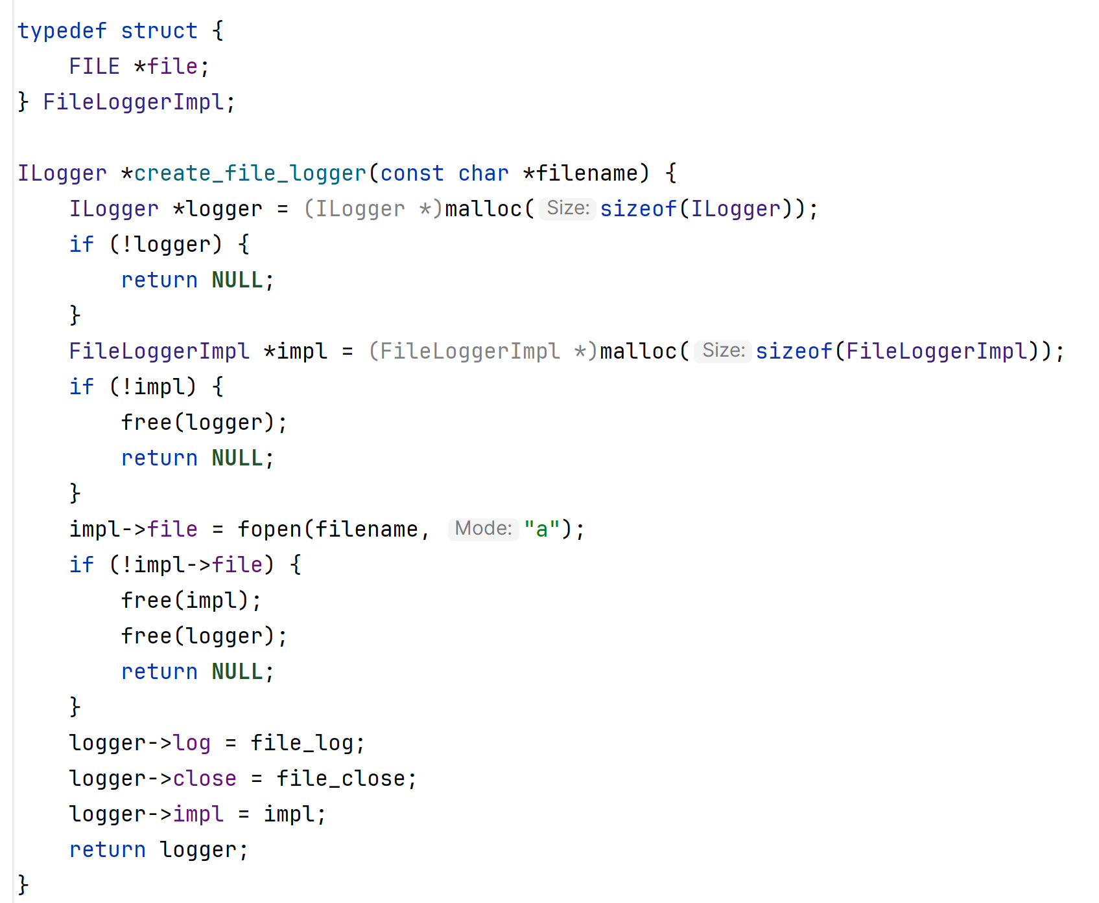
The FileLogger implementation

Slide 10
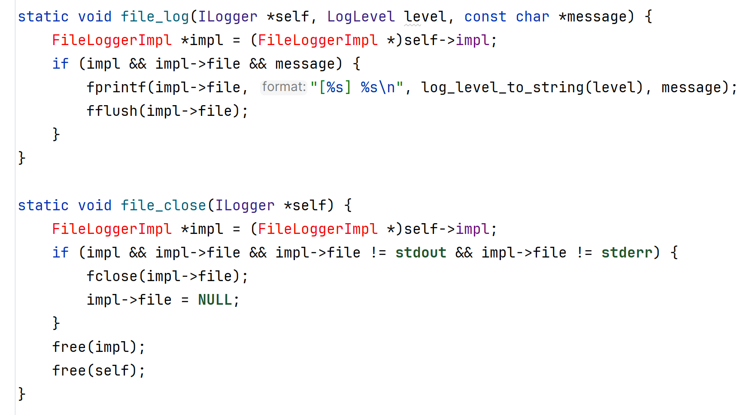
The FileLogger implementation

Slide 11
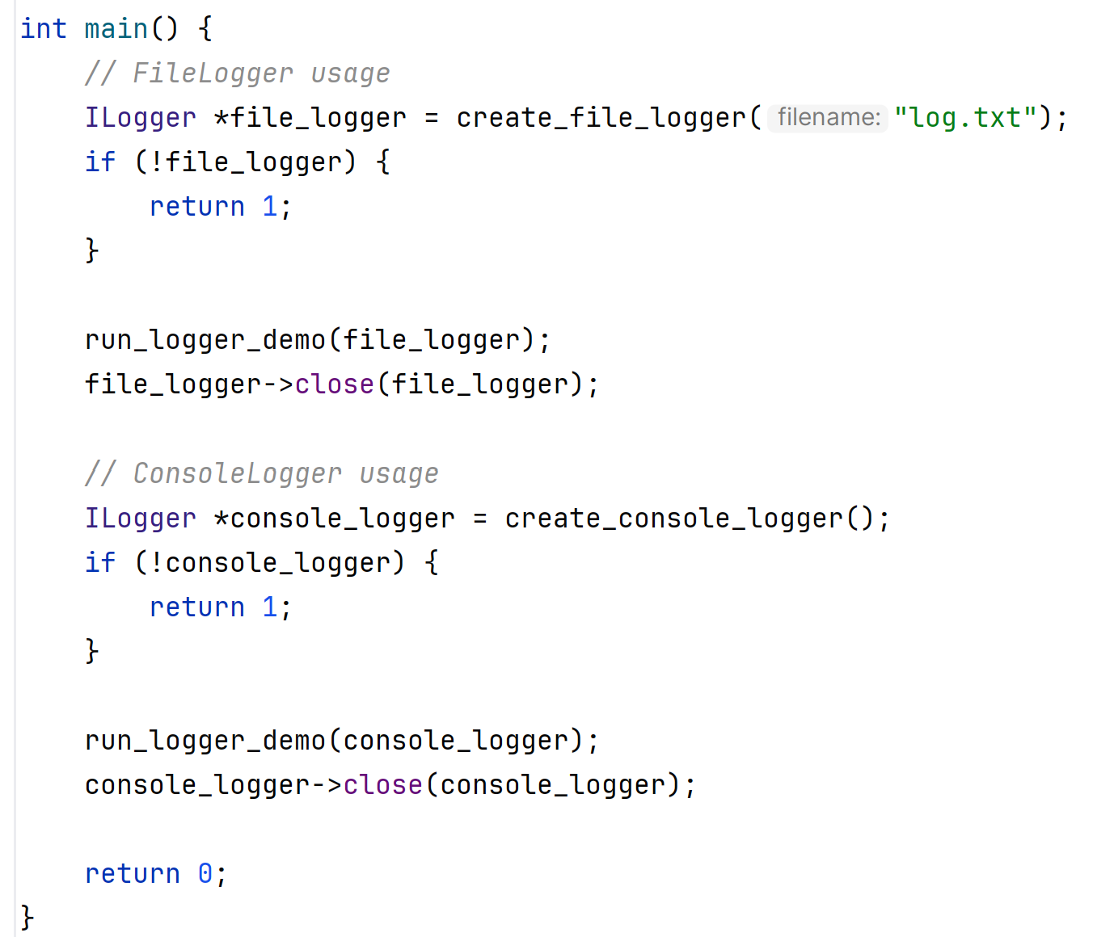
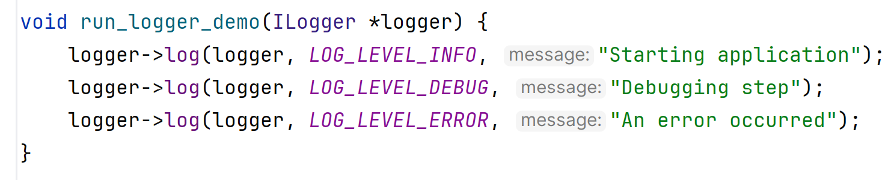
Use like in C++

Slide 12
Summary
The principles of OOD are useful in C too.
The problem is that you need to do a lot of work yourself, and also the compiler does not force you to write correctly.
Due to interop of C and C++ you can migrate incrementally (you can use shared libraries to help here).

